Slide 1
Analyse International Debt Statistics
Rushabh Halmare

Slide 2
OBJECTIVE
Project Tasks
The World Bank's international debt data
Finding the number of distinct countries
Finding out the distinct debt indicators
Totaling the amount of debt owed by the countries
Country with the highest debt
Average amount of debt across indicators
The highest amount of principal repayments
The most common debt indicator
Other viable debt issues and conclusion

Slide 3
PROBLEM STATEMENT
Governments, like individuals, may borrow money to manage their economies, finance budget deficits or capital projects, or meet the balance of payments or cost of national emergencies. For example, infrastructure spending is one costly ingredient required for a country's citizens to lead comfortable lives. The World Bank is the organization that provides debt to countries.
In this project, we are going to analyze international debt data collected by The World Bank. The dataset contains information about the amount of debt (in USD) owed by developing countries across several categories.

Slide 4
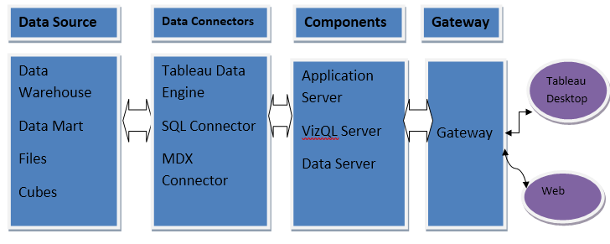
Architecture

Slide 5
Dataset Information
The dataset contains information about the amount of debt (in USD) owed by developing countries across several categories.
Country Name - Display the Country Name.
Country Code - Display the Country code based on Country Name
Counterpart - Area Name - Displays the General as World
Counterpart - Area Code - Displays the Code for World as WLD
Series Name - Displays the Reason for Debt
Series Code - Displays the unique code for Different Indicator
1970-2028 - Displays the debt in years

Slide 6
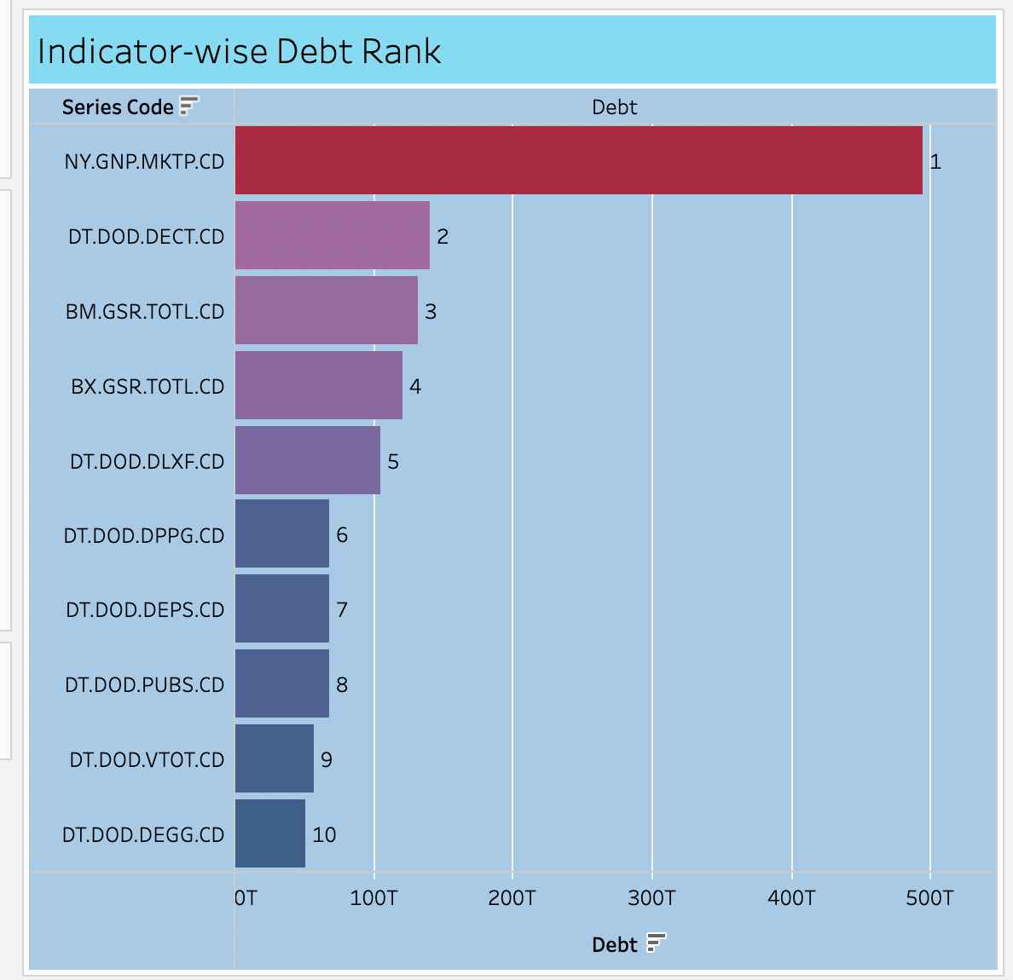
INSIGHTS
Top 10 Common indicator for Major debt?

Slide 7
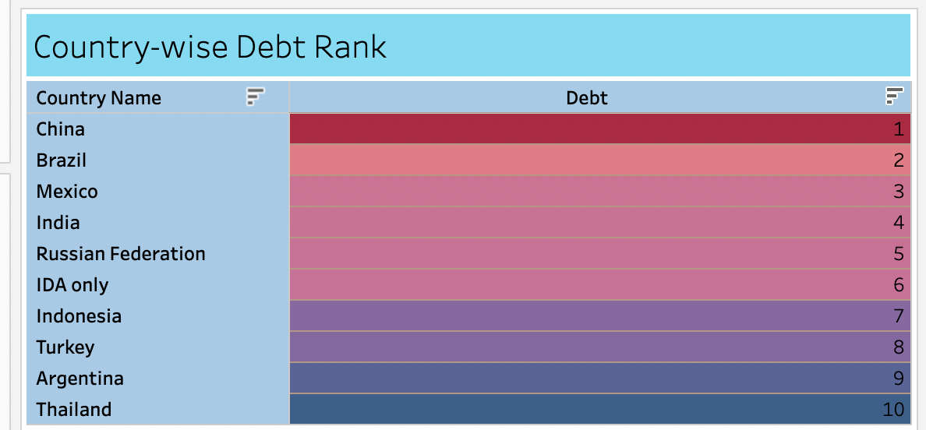
Top 10 Countries with Highest Debt

Slide 8
Key Observations:
Among all the countries China has the highest Debt and the amount of Debt China possesses is 377,762.85B.
Brazil, Mexico and India ranks 2nd, 3rd and 4th respectively among all the countries in the world.
The Indicator NY.GNP.MKTP.CD having the highest amount of principal repayments
The analysis of debt is based on total 125 countries.
The analysis is based on 383 Distinct Series Name and Indicator Code of Debt

Slide 9
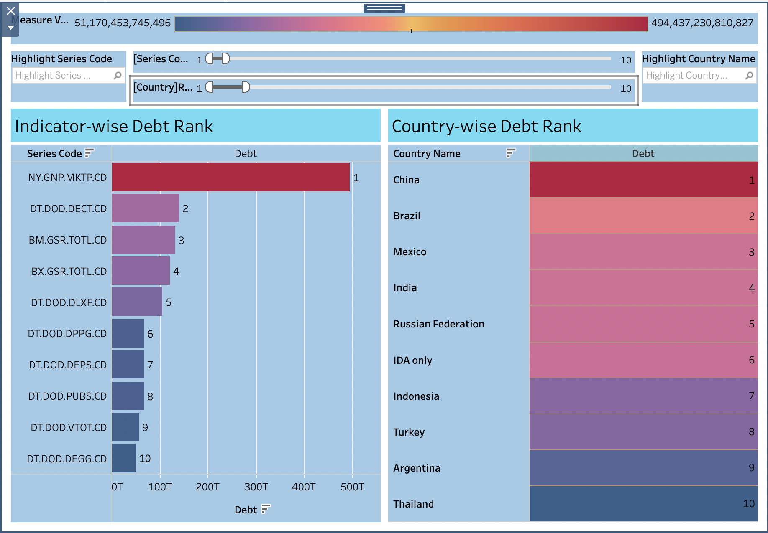
Dashboard View – Top Series Code(Indicator) and Top Countries having Highest Debt

Slide 10
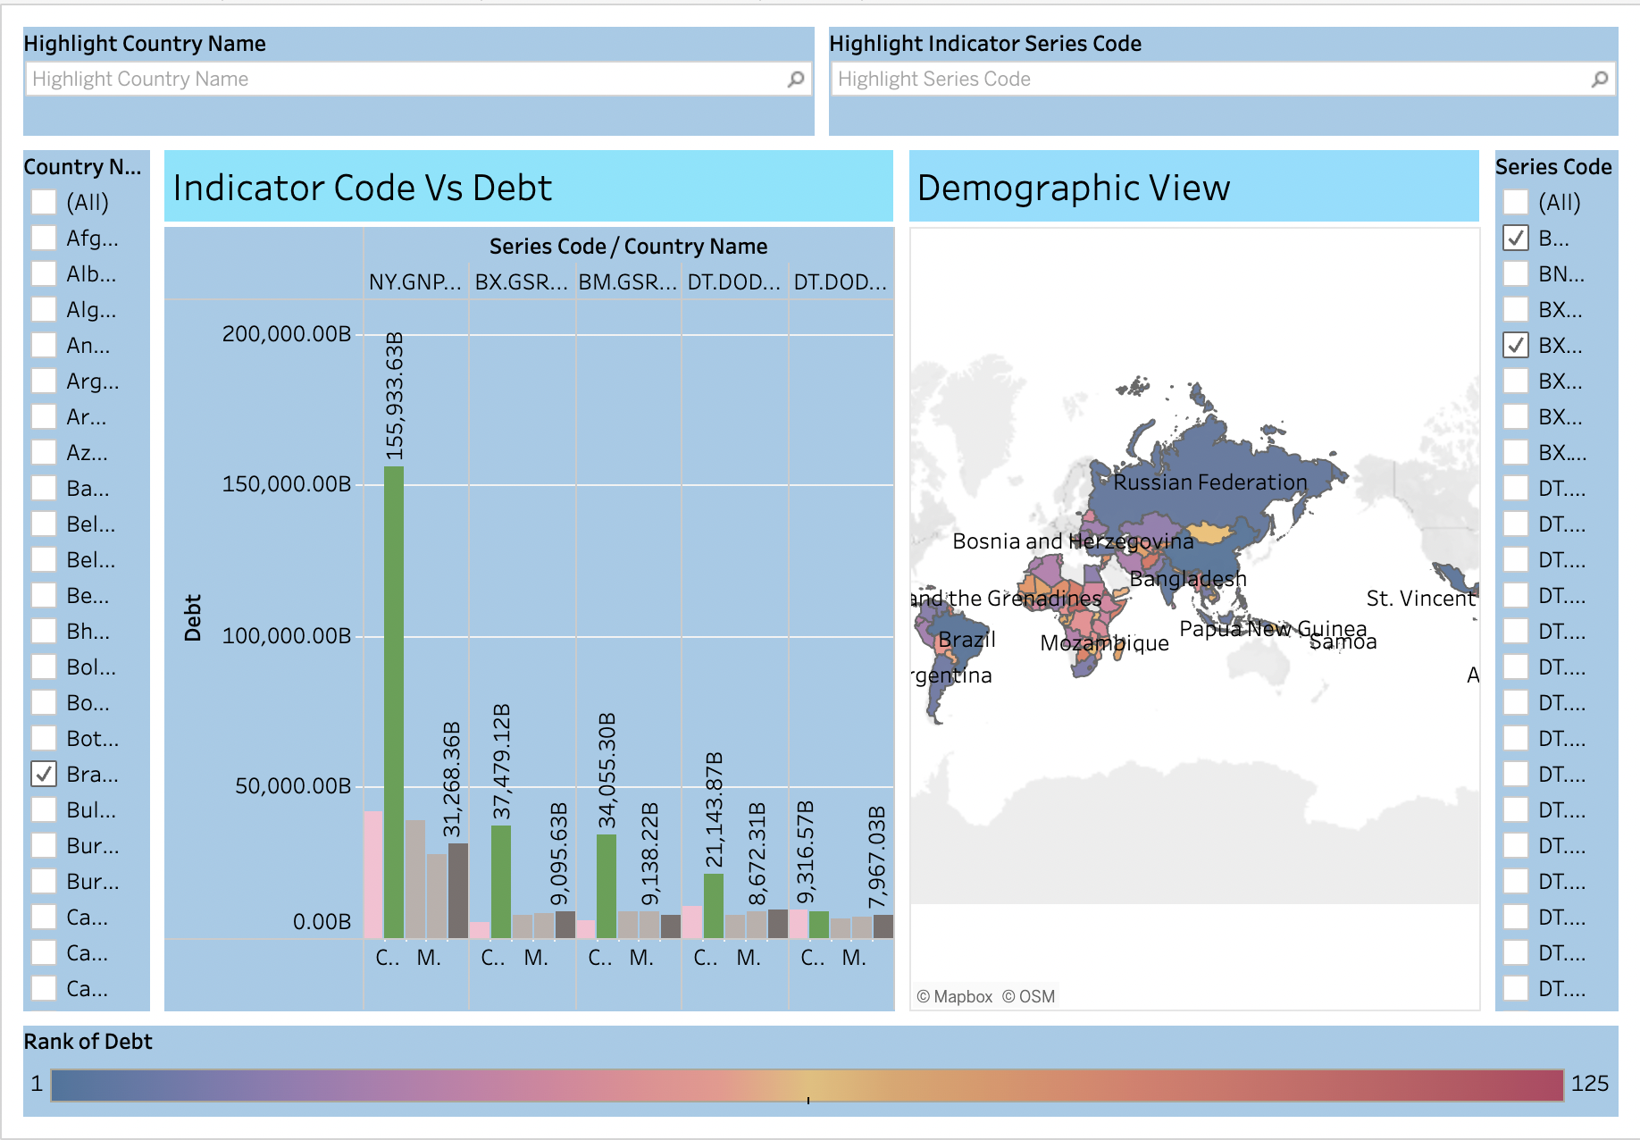
Dashboard View – Based on Each Series Code(Indicator) countries having Highest Debt and Demographically countries consisting Highest Debt(Color Code -Dark Blue – Highest Debt to Bright Orange – Lowest Debt)

Slide 11
KEY PERFORMANCE INDICATOR (KPI)
Key indicators displaying a summary of the Investment Analysis and its relationship with different metrics
Country-wise debt and Total number of debt each country possess.
Based on Series (Indicator) which country has highest Debt according to Series (Indicator) .
Analysis of each Country having Debt based on each Series (Indicator).

Slide 12
Q & A:
Q1) What’s the source of data?
The data for training is provided by the Ineuron. - Search Page | Data Catalog (worldbank.org)
Q 2) What was the type of data?
The data was the combination of numerical and Categorical values.
Q 3) What techniques were you using for data pre-processing?
Removing unwanted attributes.
Filtering out null values in our dataset.
Visualizing relation of independent variables with each other and output variables
Removing outliers.
Converting categorical data into numeric values.
Q.4) What were the libraries that used in Python?
The libraries used were Pandas and Numpy.

Slide 13
THANK YOU

